Slide 1

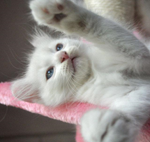
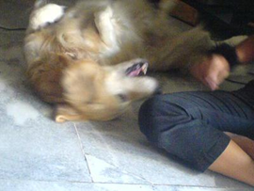
Petfinder
Team 5: Caitlin Bryant, Skyler Liu, Danilo Nikcevic, Cory Wall

Slide 2
Agenda
Introduction
Dataset Overview/ Cleaning
Critiquing Other's Work
Model Experimentation
Conclusion
Visualizing the Data

Slide 3
Introduction
Overview: PetFinder has been Malaysia's leading animal welfare platform since 2008, with a database of more than 150,000 animals. PetFinder collaborates closely with animal lovers, media, corporations, and global organizations to improve animal welfare.
Purpose: Create AI tools that can guide shelters and rescuers around the world on improving their pet profiles' appeal, reducing animal suffering and euthanization.
Problem Statement: Create models to predict the speed at which a pet is adopted, based on the pet's listing on PetFinder.

Slide 4
Dataset Overview
Dependent Variable
AdoptionSpeed: 0-4; the higher the number the longer it takes for pet to be adopted
Independent Variables
23 variables including animal type, age, breed, gender, name, color, state, fee, fur length, video amount, photo amount, health
Rows
14,993 records
Source
Malaysia's website called petfinder.my

Slide 5
Cleaning the Dataset
Took away ID and string columns: petID, rescuerID, description
Left with 20 independent variables
Checked to see if any rows had missing data or if any y's were not 0-4
There weren't any
Changed all x's into factor or numeric
10 factor, 10 numeric
Split the data 70% train and 30% test
10,495 observations for training 4,498 observations for testing

Slide 6
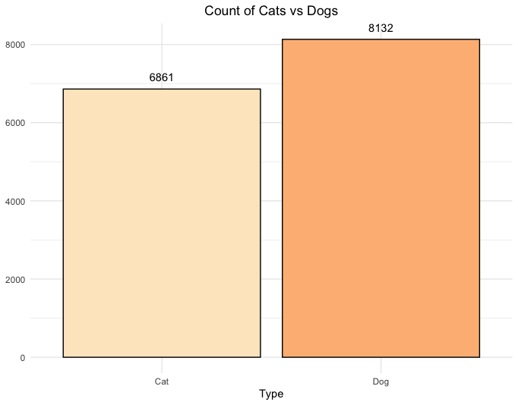
Visualizing the Data

Slide 7
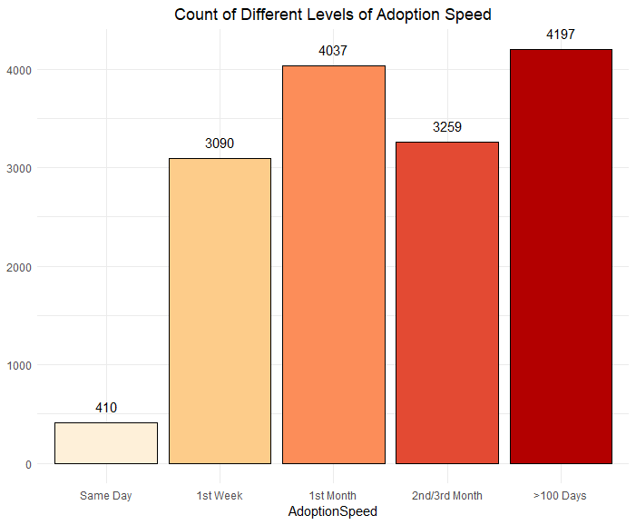

Slide 8
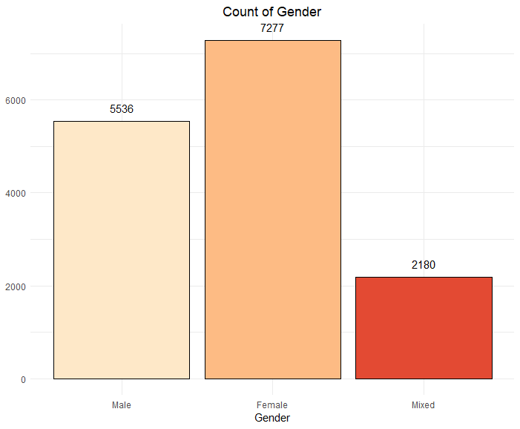

Slide 9
Critiquing Other's Work
Preparation before modeling
Do optimize your model's hyperparameters
Don’t use inappropriate models
Notes:
In this competition you will be developing algorithms to predict the adoptability of pets - specifically, how quickly is a pet adopted?
Do take the time to understand your data
Split Data - Train vs. Test

Slide 10
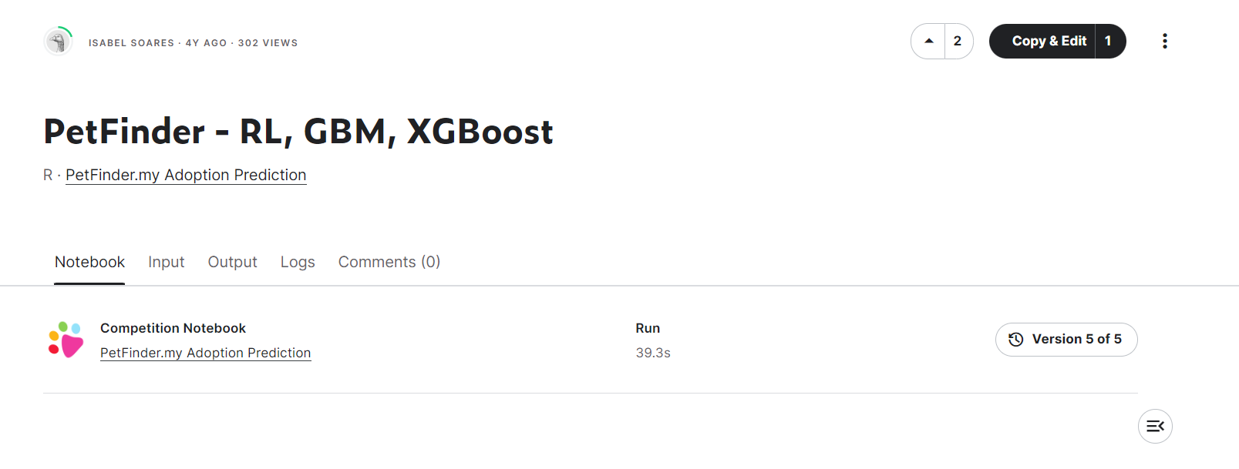
Preparation before modeling
https://www.kaggle.com/code/belsdiniz/petfinder-rl-gbm-xgboost

Slide 11
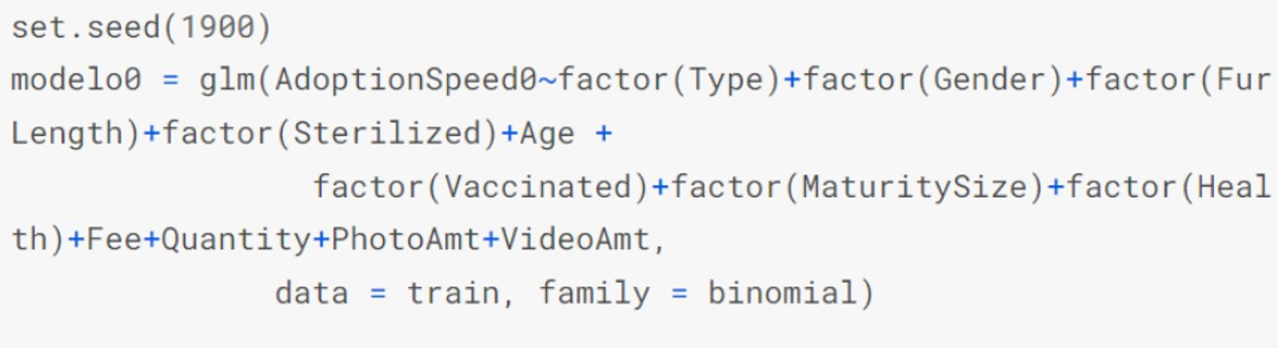
Preparation before modeling
Notes:
We choose this code because the same predictors
Firstly, The model can be easy and simple if the author coerce the data type before changing the dataset

Slide 12
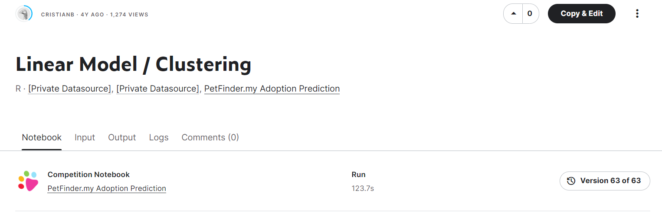
Don’t use inappropriate models
https://www.kaggle.com/code/cjbecerr/linear-model-clustering

Slide 13
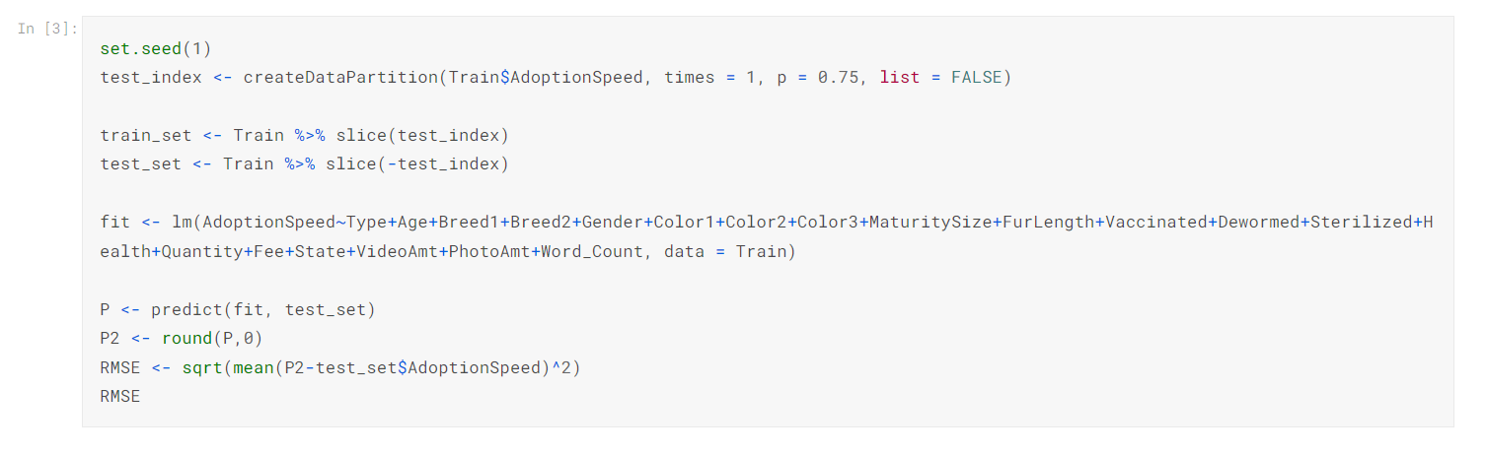
Don’t use inappropriate models

Slide 14
Do optimize your model's hyperparameters
https://www.kaggle.com/code/belsdiniz/petfinder-rl-gbm-xgboost

Slide 15
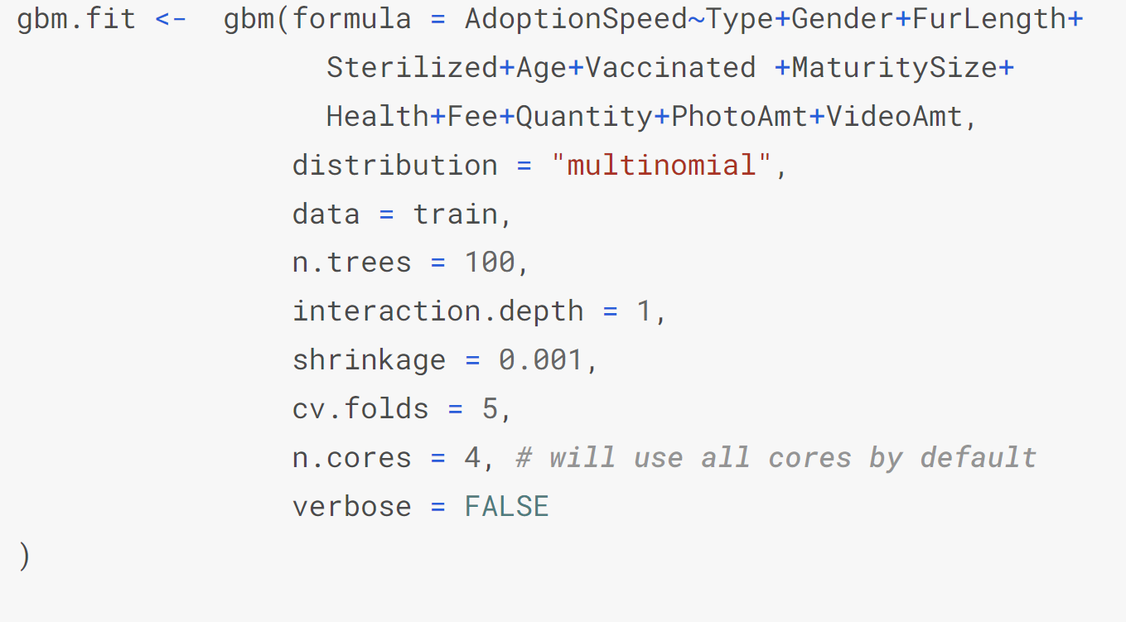
Do optimize your model's hyperparameters
For the boosting model, tuning the n.trees, interaction.depth, shrinkage to find the best parameters

Slide 16
Model Experimentation
XGBoost
LDA
Random Forest
Neural Network

Slide 17
Conclusion
LDA accuracy: 35.79%
RF accuracy: 40.60%
XGBoost accuracy: 37.06%
Tune XGBoost accuracy: 38.35%
Neural Network accuracy: 38%
Tune RF accuracy: 40.62%

